Slide 1

Ref U Gee
Someone who has been forced to flee their country because of the persecution, war, or violence
June 10th 2019

Slide 2

Focus for Change
USA for UNHCR protects and empowers refugees and engages Americans in support of the world’s 68.5 million displaced people.
Help enhance our website with the ability for two-way communications that inspires interest, engenders empathy and allows Americans to more easily engage on refugee issues.

Slide 3

Help needed
A record 68.5 million people have been forced to flee their homes.
Every 2 seconds someone was uprooted and forced to flee due to violence, conflict or persecution.
85% of Refugees are generously hosted in developing nations where economic opportunities are limited.

Slide 4

Personal Story
What stories are important to people
Provide information that can help people make a decision to get involved
A little of your involvement can greatly improve someone's life

Slide 5

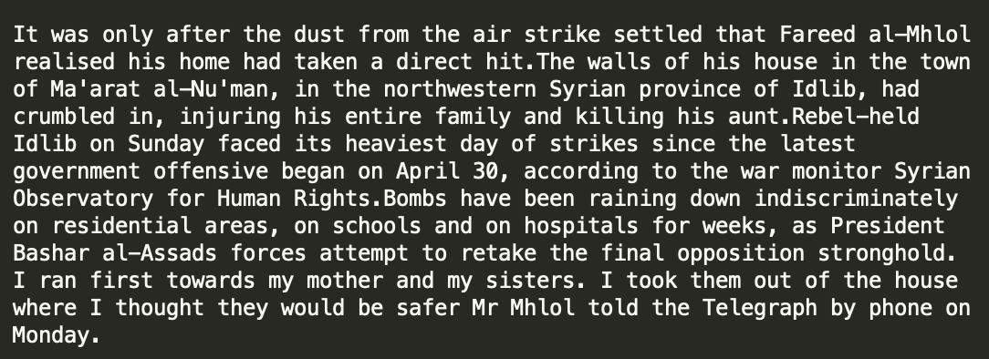
Who Cares?
The "Refugee News Dataset" already classified this story as Syria with a natural sentiment
Using AWS Comprehend Custom entity recognition more definitions are extracted that define the persona's that these stories would resonate with.
Increase the likelihood of patrons taking action ( in this case making a donation) for the cause.

Slide 6
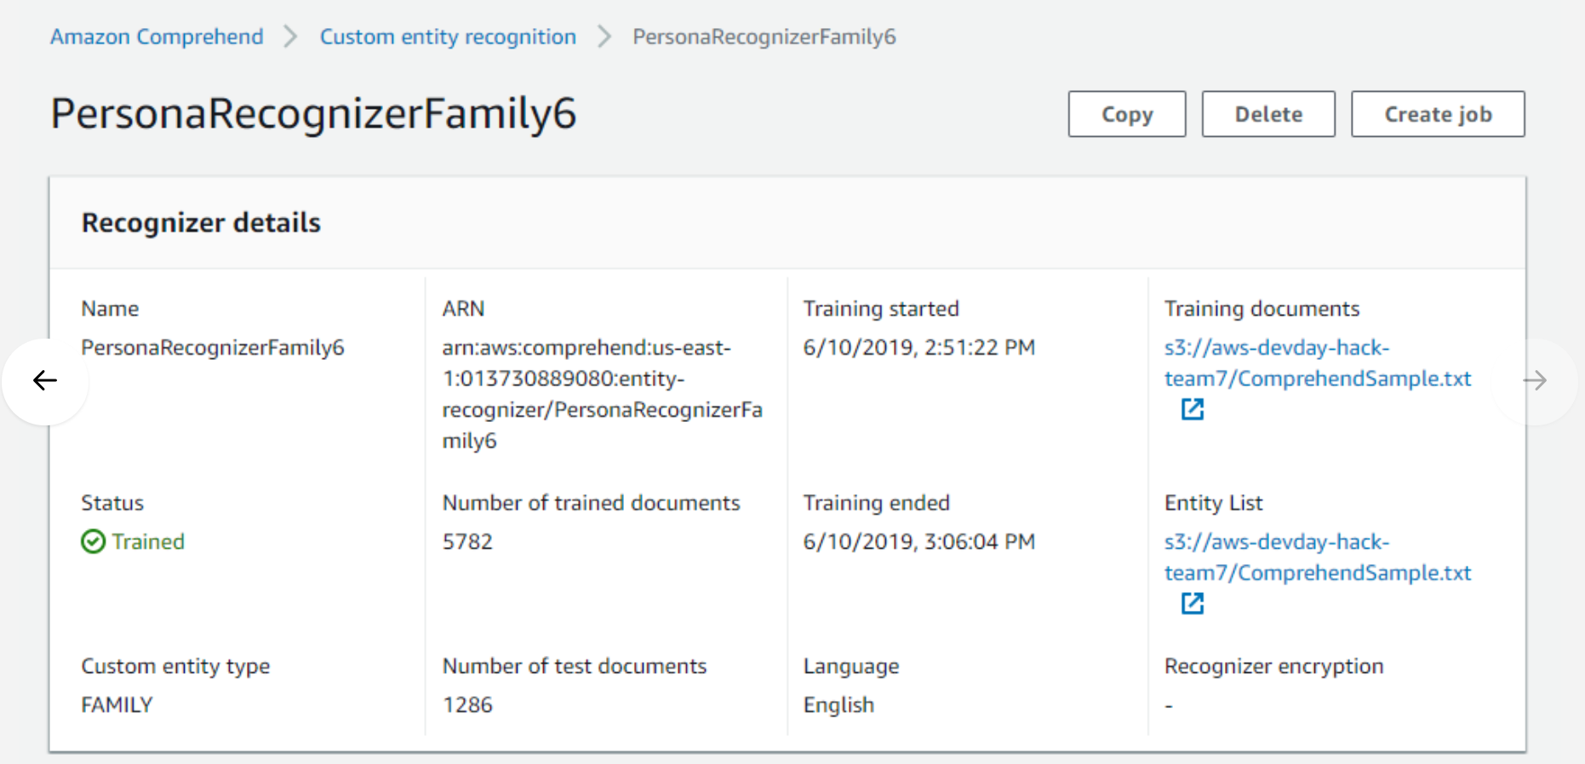
AWS Comprehend
Personas evolve to the needs of how UNHCR determines customer

Slide 7
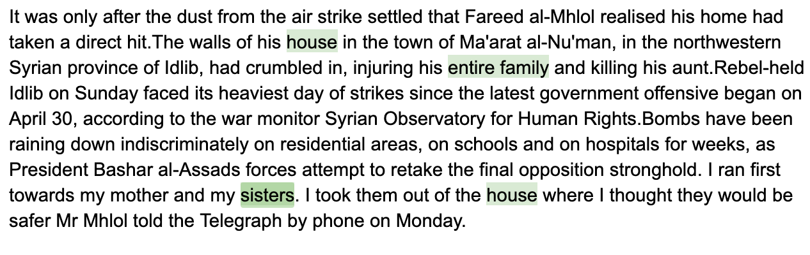
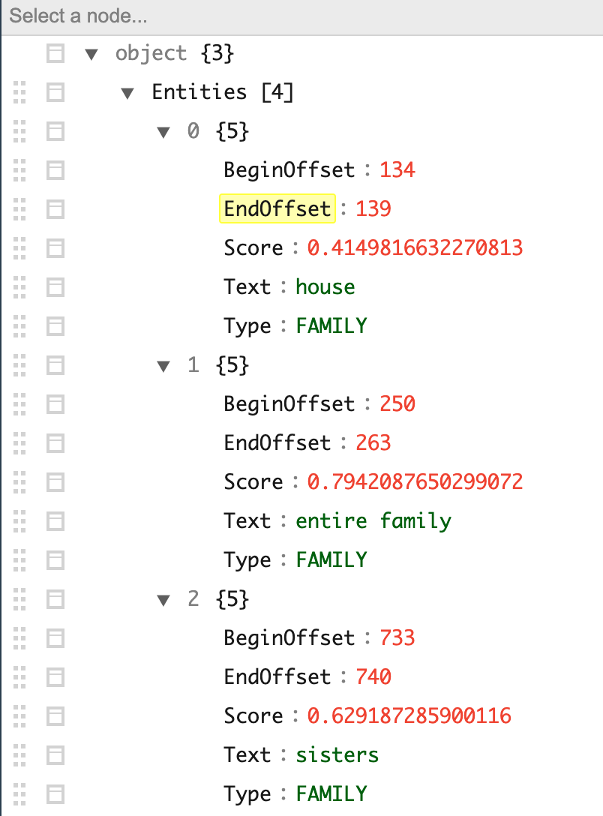
AWS Comprehend
Scores are created for each persona for each story/article
Score are used to target the persona who would want the story/article

Slide 8
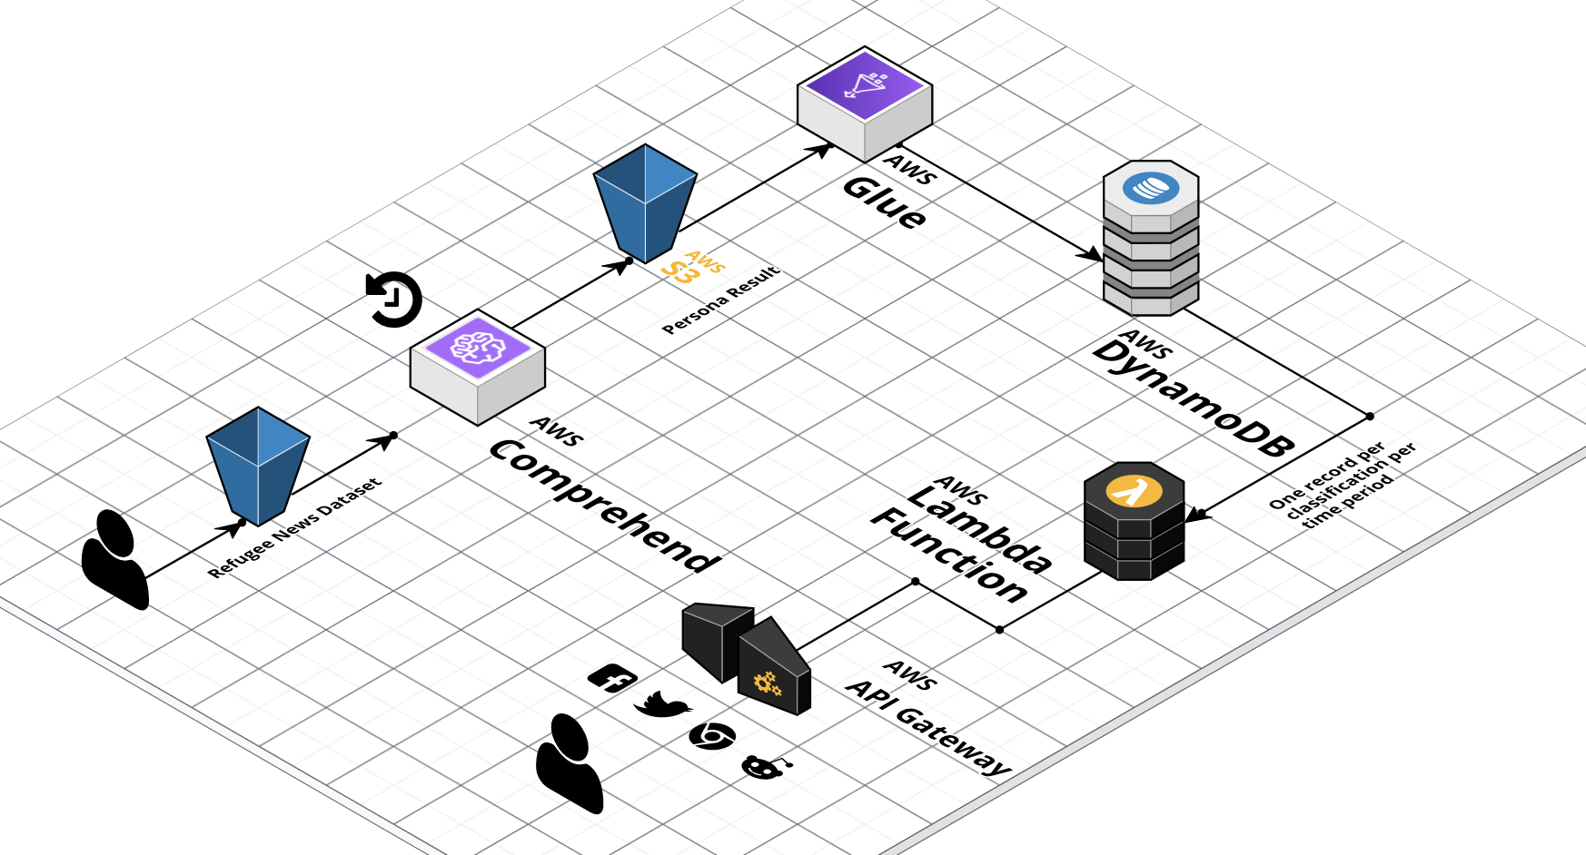
Solution

Slide 9
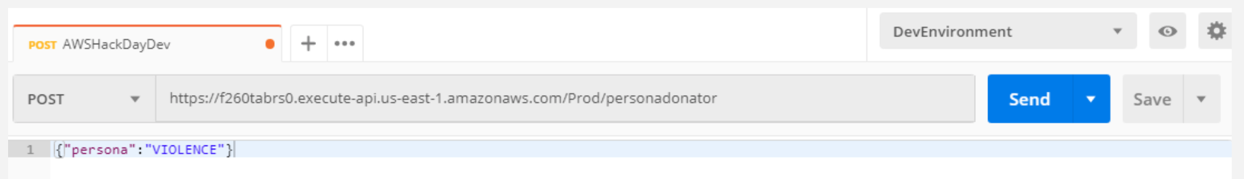
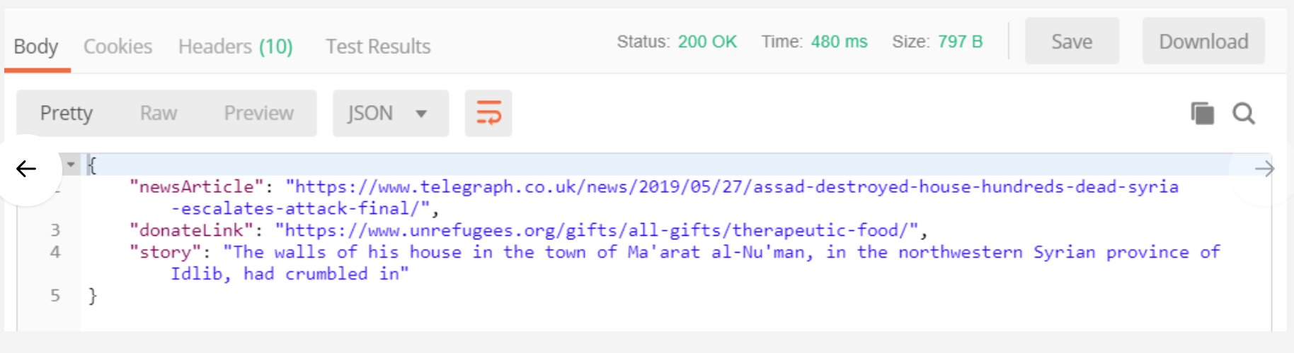
Key Information
Provide the Persona type to the API and the result would be the story/article with the most impact. It also provides the source, story, and the persona specific donate link.

Slide 10
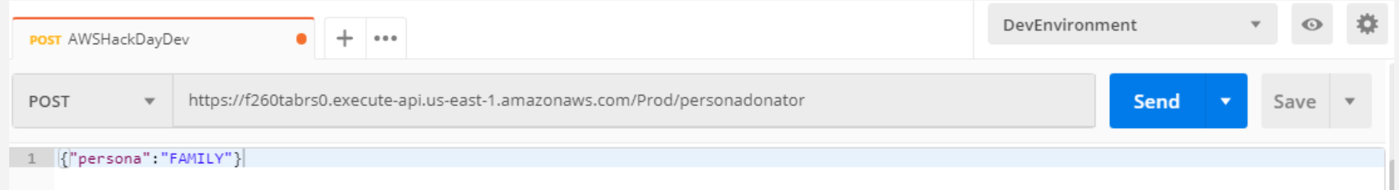
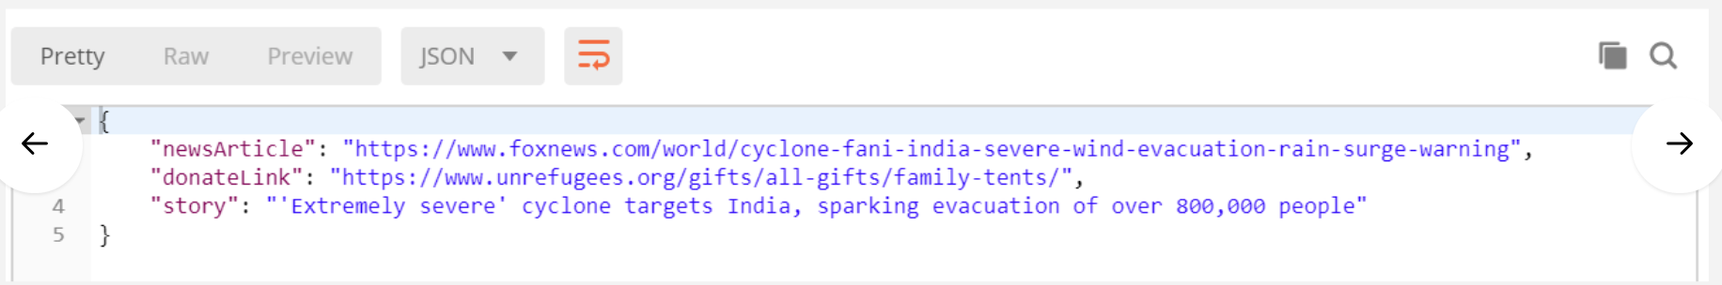
Key Information
This can be distributed in a multiple ways for UNHCR

Slide 11
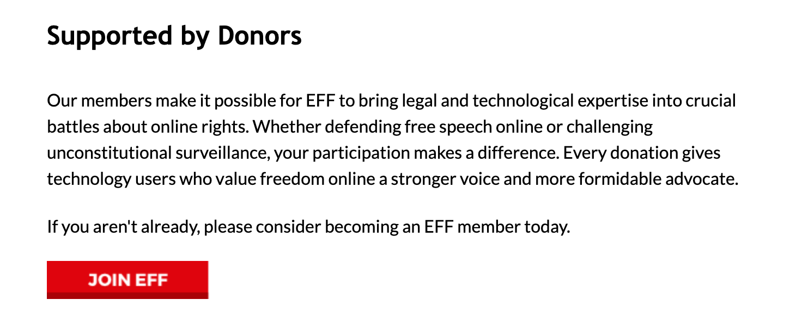

Leveraging this Concept
Content can be shared to build engagement either via Facebook posts, Email Campaign, or other Ad campaigns
A Story we thought you would be interested in
It was only after the dust from the air strike settled that Fareed al-Mhlol realised his home had taken a direct hit.The walls of his house in the town of Ma'arat al-Nu'man, in the northwestern Syrian province of Idlib, had crumbled in, injuring his entire family and killing his aunt.Rebel-held Idlib on Sunday faced its heaviest day of strikes since the latest government offensive began on April 30, according to the war monitor Syrian Observatory for Human Rights.Bombs have been raining down indiscriminately on residential areas, on schools and on hospitals for weeks, as President Bashar al-Assads forces attempt to retake the final opposition stronghold. I ran first towards my mother and my sisters. I took them out of the house where I thought they would be safer Mr Mhlol told the Telegraph by phone on Monday.
Donate

Slide 12


Message Out
Personal post of story article that is for the defined for a persona
Target email campaign for persona types
Social media campaign using that social demographic classification

Slide 13


Improvement
Each distribution will have a specific donation link to track conversions.
Evolve the persona classification for more impactful stories for that group
Measure the differences in how those persona's donate

Slide 14
Social Impact & Value
Only sharing stories and articles that are important to the partners and help increase donation for specific causes for those personasTarget email campaign for persona types

Slide 15
Originality
Providing the Data Analytics Group ability to integrate their CRM Data and achieve targeted marketing and sharing actionable information with partners

Slide 16
Feasibility
No capital expense in this technology and no going subscription. Solution is pay per use/ OnDemand

Slide 17
Usability
A majority of the evolution would occur with training the custom definition within AWS Comprehend and integrate with The UN Refugee Agency's current CRM

Slide 18
Engagement
Drive larger donations to causes people identify with

Slide 19
Go-To-Market Strategy & Promotion
The API Solution can be implemented with AWS Platforms and improved incrementally.

